Slide 1
Vector Spaces and Subspaces
MATH 4341 : Linear Algebra
Aashnan Rahman
Junior Lecturer
Department of Computer Science and Engineering (CSE)
Islamic University of Technology

Slide 2
Vectorspace
A space formed of a bunch of vectors.
Is R² a vector space?
1
2
00
𝝿
e

Slide 3
Vectorspace
Characteristics of vector space -
Linear combination of any vectors within a vector space must also reside within that vector space.
Origin must be part of the vector space.

Slide 4
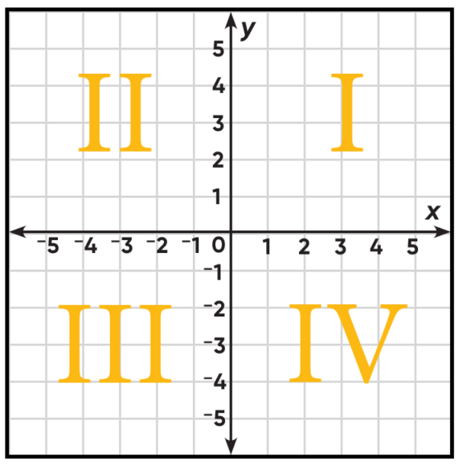

Quick question
Is the first quadrant a vectorspace?
Contains origin
Contains linear combination of the vectors inside the vector space.

Slide 5
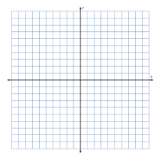
What’s a vector space inside R²?
SUBSPACE

Slide 6
Subspace
Subset of a vector space
Characteristics -
Same as vector space.

Slide 7
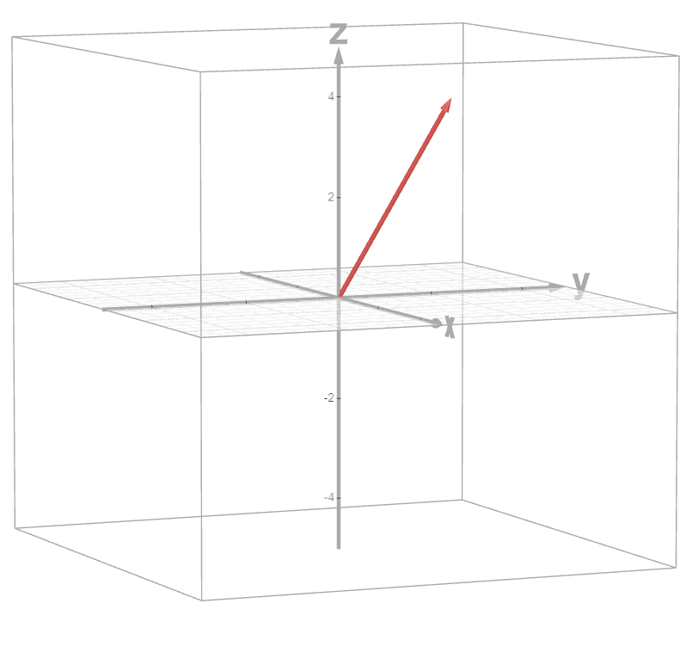
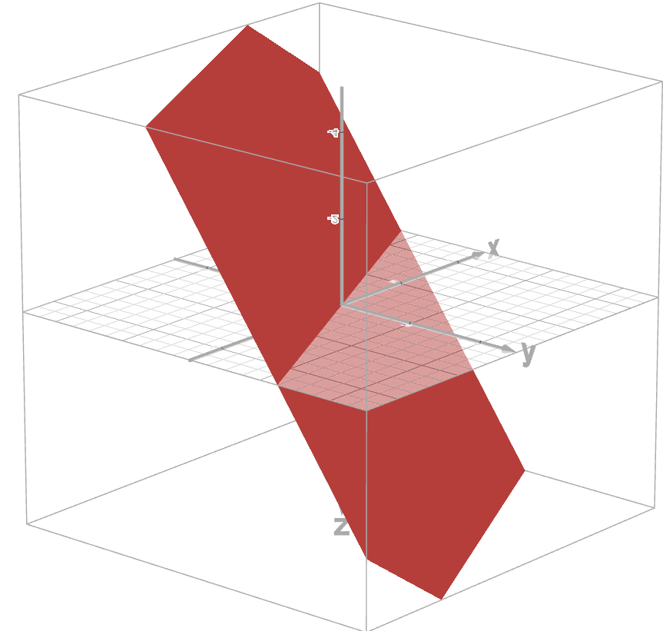
Subspace
Are they subspaces of R³?

Slide 8
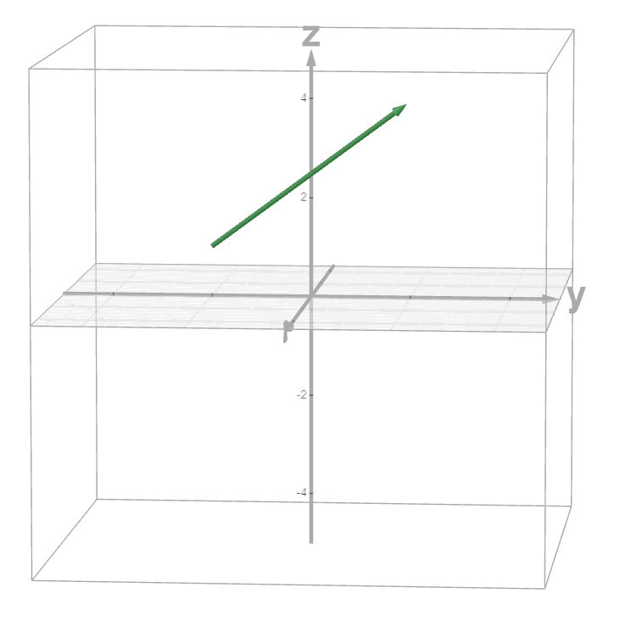
Subspace
So, can any line be a vector space?

Slide 9
Recap
In which space do these vectors lie?
x₁
x₂
x₃
………….
x_{n}
1
2
3
1
2
R²
R³
R^{n}

Slide 10
Subspace
What are the possible subspaces of R²?
R² itself
Origin
Vector(line) passing through the origin

Slide 11
Subspace
What are the possible subspaces of R³?
R³ itself
Origin
Vector(line) passing through the origin
Plane passing through the origin

Slide 12
Subspace
Subspace P
A line through origin in R³
Subspace Q
A plane through origin in R³

Slide 13
Subspace
Is (P ⋃ Q) a subspace?
Is (P ∩ Q) a subspace?

Slide 14
Column Space
What is the space covered by the columns of A?
1 -1
2 4
3 0
A plane in R³ passing through origin.

Slide 15
Column Space
A subspace covered by the columns of any matrix.
1 0
0 1
3 6
2 4

Slide 16
Column Space
What’s the column space of matrix A?
1 1 2
2 1 3
3 1 4
4 1 5

Slide 17
Column Space
For which b can Ax=b be solved?
1 1 2
2 1 3
3 1 4
4 1 5
b₁
b₂
b₃
b₄
x₁
x₂
x₃
=

Slide 18
Column Space
1
2
3
4
1
1
1
1
2
3
4
5
b₁
b₂
b₃
b₄
x₁
+x₂
+x₃
=

Slide 19
Null Space
For which x can I solve Ax=0?
1 1 2
2 1 3
3 1 4
4 1 5
0
0
0
0
x₁
x₂
x₃
=

Slide 20
Null Space
Solutions of Ax = 0
1
2
3
4
1
1
1
1
2
3
4
5
0
0
0
0
x₁
+x₂
+x₃
=

Slide 21
Null Space
For which x can I solve Ax=0?
0
0
0
1
1
-1
C

Slide 22
Null Space
Is the span of the null space a subspace?
1
1
-1
C
Yes

Slide 23
Null Space
Null space of Independent matrices?
0
0
0

Slide 24
Quick Question
Is the solution a subspace?
1 1 2
2 1 3
3 1 4
4 1 5
1
2
3
4
x₁
x₂
x₃
=

Slide 25
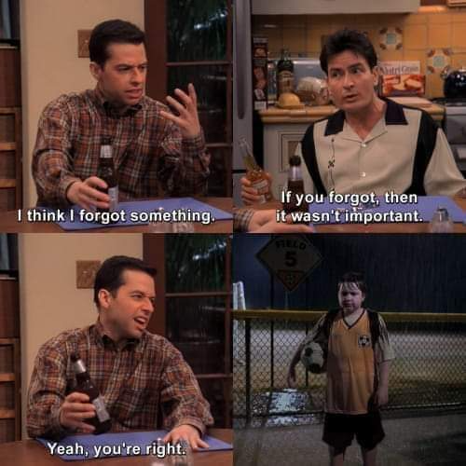
*while determining vector spaces*
*the origin

Slide 26
References
Gilbert Strang (L6)

Slide 27

¡THANKS!

